Slide 1
SEXUAL TRANSMITTED INFECTIONS(STIs) OTHER THAN HIV
Dr Elimokozi Maleko
Dr Patrick Mlowezi
Facilitator : Prof Munseri

Slide 2
OUTLINE
INTRODUCTION
Definition of terms
Epidemiology
RISK FACTORS
CLASSIFICATION OF STIs
MANAGEMENT STRATEGIES
COMPLICATIONS
CONTROL AND PREVENTION STRATEGIES
REFERENCES

Slide 3
INTRODUCTION
STIs (Sexually Transmitted Infections)
Are infections that are predominantly transmitted through sexual contact with a person who has STI
Persons maybe infected and have potential to infect others without showing signs and symptoms of disease

Slide 4
STDs (Sexually Transmitted Diseases)
A group of communicable diseases transmitted predominantly by unprotected sexual contact including vaginal intercourse, oral or anal sex, showing signs and symptoms
Notes:
Protozoa, fungi and, bacterial most common curable
Viral –Lack or Limited treatment options
Vaccination – HBV, HPV prevention HCC,CaCx

Slide 5
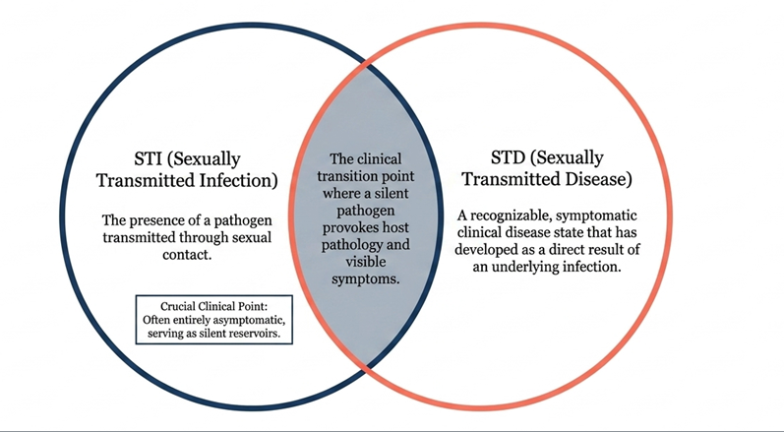

Slide 6
EPIDEMIOLOGY
In 2020 the incidence of STI among people aged 15-49 years was estimated to be 374 million worldwide, approximately 1 million infection
In most cases are asymptomatic
These infections include curable STIs: Chlamydia, Syphilis, Gonorrhea, and Trichomonas

Slide 7
An estimated 8 million adults between 15 and 49 years old were infected with syphilis in 2022
An estimated 520 million people aged 15–49 years (13%) worldwide have herpes simplex virus type 2 (HSV-2) infection, the main cause of genital herpes
Human papillomavirus (HPV) infection is associated with over 311 000 cervical cancer deaths each year
Harfouche M et al. Estimated global and regional incidence and prevalence of herpes simplex virus infections and genital ulcer disease in 2020: mathematical modelling analyses. Sex Transm Infect. 2025 May 19;101(4):214-223. doi: 10.1136/sextrans-2024-056307. PMID: 39658199

Slide 8
1.1 million pregnant women were estimated to be infected with syphilis in 2022, resulting in over 390 000 adverse birth outcomes
STIs have a direct impact on sexual and reproductive health through stigmatization, infertility, cancers and pregnancy complications and can increase the risk of HIV

Slide 9
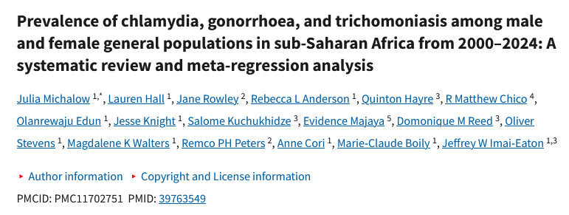

Slide 10
Article review
Study Objective: Prevalence of chlamydia, gonorrhoea, and trichomoniasis among male and female general populations in sub-Saharan Africa from 2000–2024
Study Methods :A systematic review and meta-regression analysis, included 211 studies from 28 countries

Slide 11
Findings :
In 2020, estimated prevalence among 15–49-year-olds in SSA:-
Chlamydia was 6.6% (females) and 4.7% (males)
Gonorrhoea was 2.4% (females) and 1.7%(males)
Trichomoniasis was 6.8%(females) and 1.7%(males)
From 2010–2020, chlamydia prevalence increased by 34.5% in SSA, while gonorrhoea and trichomoniasis trends were not statistically significant

Slide 12
Conclusion
SSA has a high, geographically varied STI burden, with increasing prevalence of chlamydia
Chlamydia and gonorrhoea prevalence were highest in Southern and Eastern Africa, whereas trichomoniasis was similar across sub-regions

Slide 13
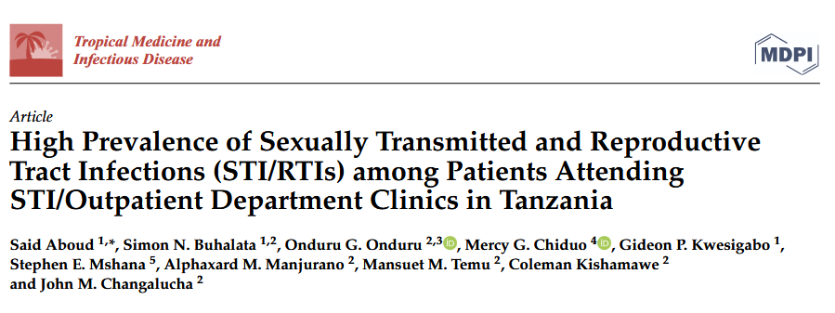
Epidemiology of STI in Tanzania

Slide 14
Article review
Study Objective: To determine the prevalence of STIs and associated risk factors among who presented with genital symptoms in STI/outpatient department (OPD) clinics in two regional referral hospitals and six health centres in six regions in Tanzania 2014 to 2016
Study Methods : Cross-sectional study (2014-2016) at 8 health facilities across 6 regions(Dar es Salaam, Tanga, Kilimanjaro, Mbeya, Dodoma and Mwanza).
A total of 1243 Patients with genital symptoms were tested using molecular diagnostics; syndromic management was also evaluated.

Slide 15
Findings :
The overall prevalence of all STIs was 55.8%. Women accounted for majority 86.3%
T. vaginalis 39.9% ,
N. gonorrhoeae 13.4%,
C. trachomatis 13.4% and
M. genitalium 5.1%
High prevalence of 68.6%, 57.9%, and 47.9% of all STIs were observed in Dodoma, Mwanza, and Dar es salaam respectively

Slide 16
Conclusion :
The study reported high prevalence of STIs and these infections are common and more prevalent in urban areas among patients attending STI clinics in Tanzania
T. vaginalis, N. gonorrhoeae and C. trachomatis were more common and prevalent and were found infecting more young adults both men and women

Slide 17
RISK FACTORS
Behavioural factors
  Having multiple sexual partners
  Having high risk partner
  Unsafe sex
  Alcohol and drug abuse
Socio-economic
  Lack of information on STI
  Occupation (transactional sex)
  Poverty
Endogenous
  Unhygienic conditions eg vaginosis, candidiasis
Cultural
  Female genital mutilation
  Widow inheritance
Biological
  Age; Adolescents and youth are at most risk
  Gender; Female are more likely to be infected compared to males
Political
  Wars and civil crisis
Iatrogenic
  Unsafe procedures eg abortions

Slide 18
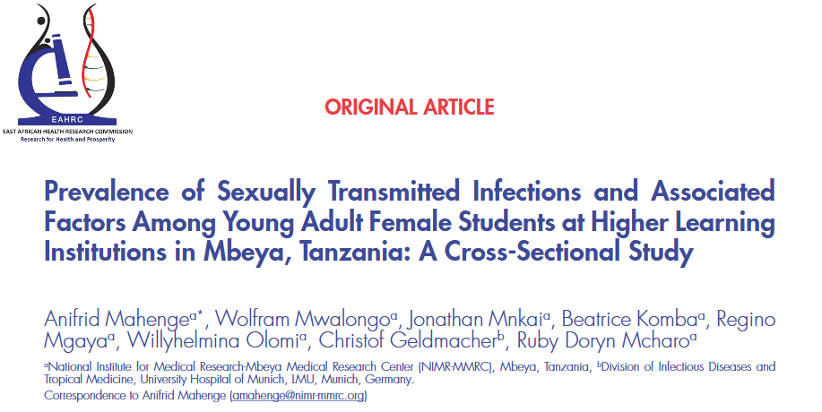

Slide 19
Article review
Study Objective: To assess how common STIs are and identify risk factors among young female students in Mbeya, Tanzania
Methods: A cross-sectional study was conducted from February 2020 to June 2021
150 female students aged 18-24 years from 5 HLIs
Real-time Polymerase Chain Reaction (RT-PCR) to detect for Mycoplasma genitalium (MG), Chlamydia trachomatis (CT), Neisseria gonorrhoea (NG), Trichomonas vaginalis (TV), Ureaplasma parvum (UP), Mycoplasma hominis (MH) and Ureaplasma urealyticum (UU)

Slide 20
Findings :
Out of 150 participants, 19.33% had Mycoplasma genitalium , Chlamydia trachomatis , Neisseria gonorrhea, and Trichomona vaginalis, Ureaplasma parvum were 56%, and a combination of Mycoplasma hominis and Ureaplasma urealyticum were 38%
More than half (59.01%) of positive cases had multiple infections
The majority of participants had poor levels of STI knowledge.
Being a young female student (< 20 years) and having a history of practicing oral sex were significantly associated with an increased likelihood of having an STI

Slide 21
Conclusion :
STI diagnosis using molecular assays is beneficial in detecting pathogens not routinely tested in health facilities and for identifying asymptomatic infected individuals
There is a paramount necessity for health promotion, to scale up STI education and prevention intervention strategies among female students in HLIs

Slide 22
CLASSIFICATION OF STIs
Etiological
Syndromic

Slide 23
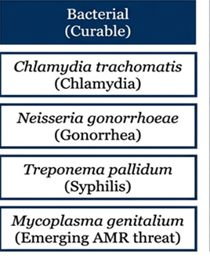
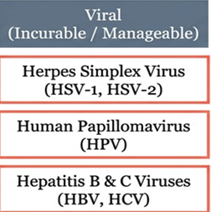
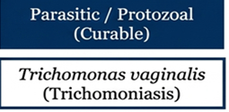
ETIOLOGICAL

Slide 24
SYNDROMIC CLASSIFICATION OF STIs
According to WHO STI’s are classified as:
Urethral discharge syndrome
Vaginal discharge syndrome
Lower abdominal pain
Genital ulcer disease syndrome
Anorectal discharge

Slide 25
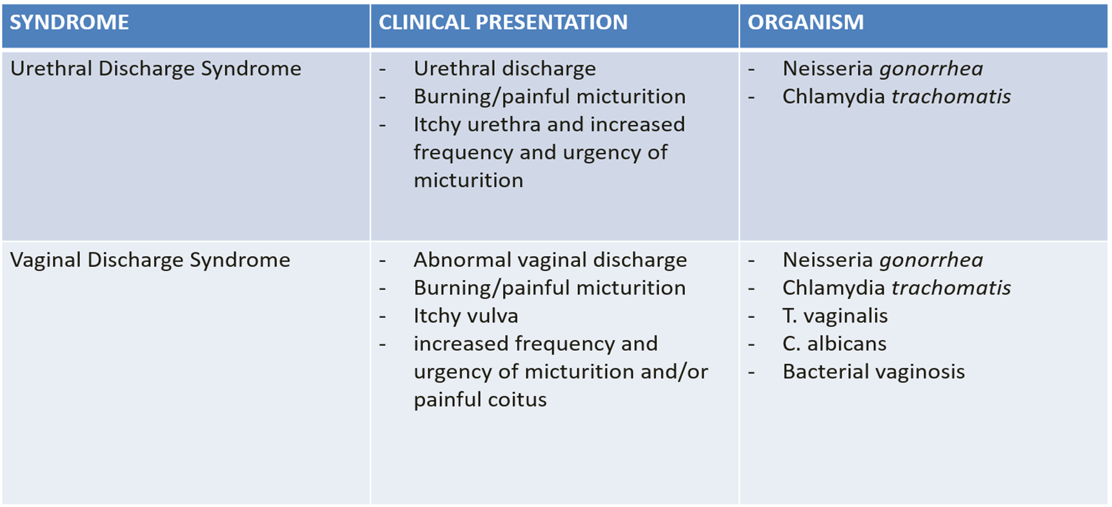

Slide 26
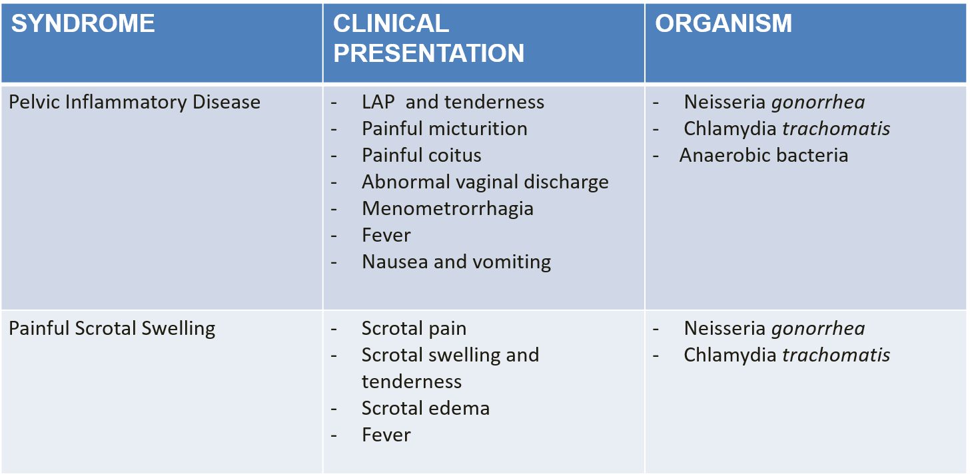
Notes:
Most common anaerobes causing PID =Prevotella, bacteroides fragilis, peptostreptococus

Slide 27
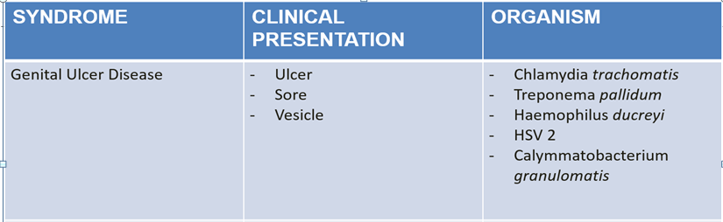
Notes:
Virus= causes blister- rupture= ulcer
Bacteria= ulcers

Slide 28
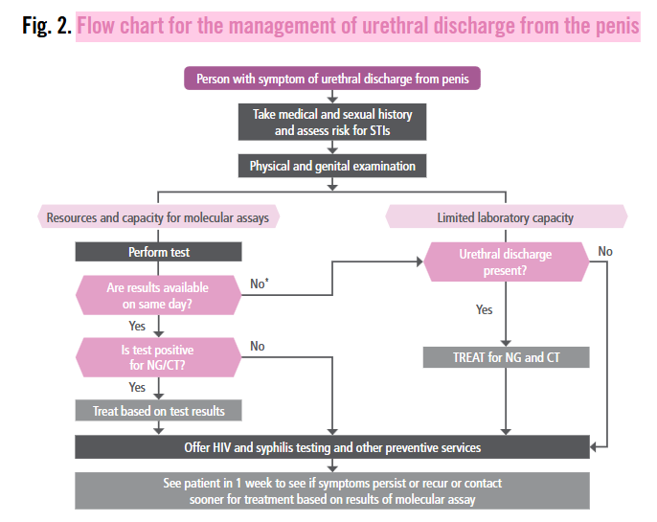
URETHRAL DISCHARGE SYNDROME
WHO GUIDELINE 2021

Slide 29
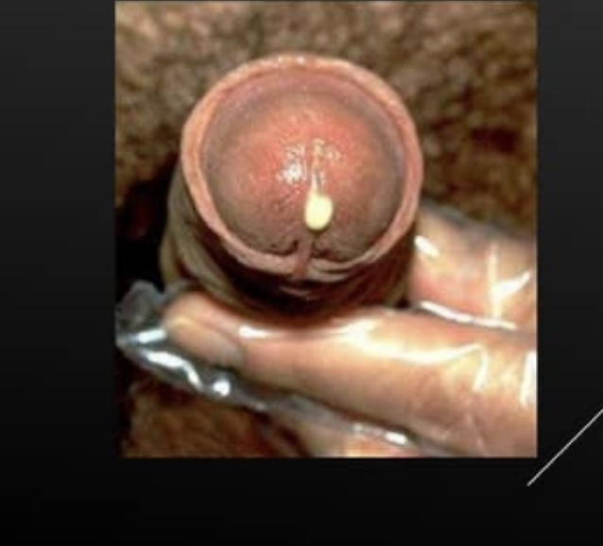

Slide 30
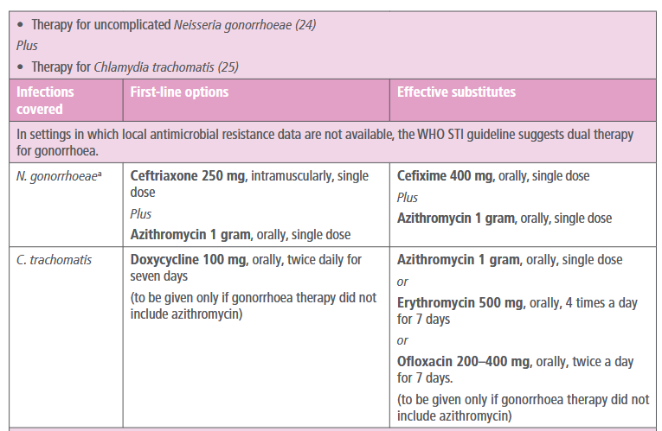
WHO RECOMMENDED TREATMENT

Slide 31
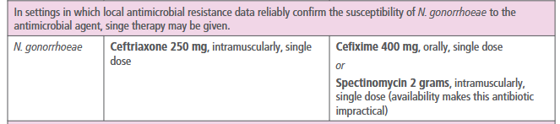

Slide 32
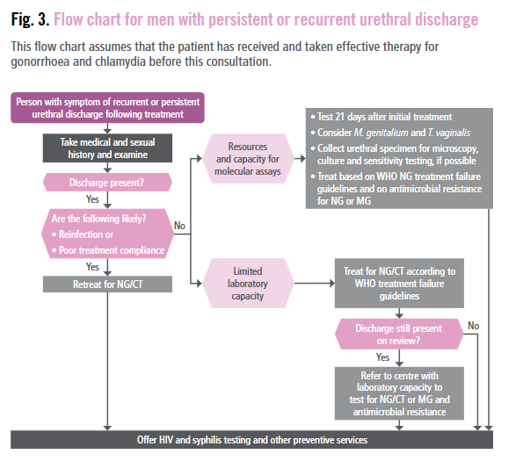
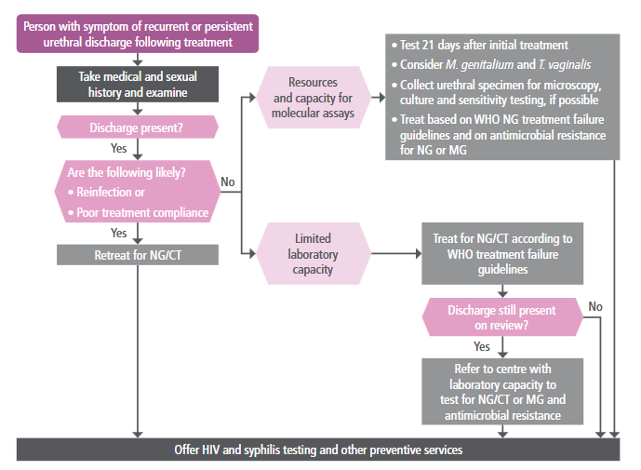
WHO GUIDELINE 2021

Slide 33
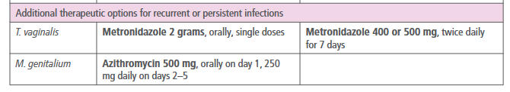
WHO RECOMMENDED TREATMENT

Slide 34
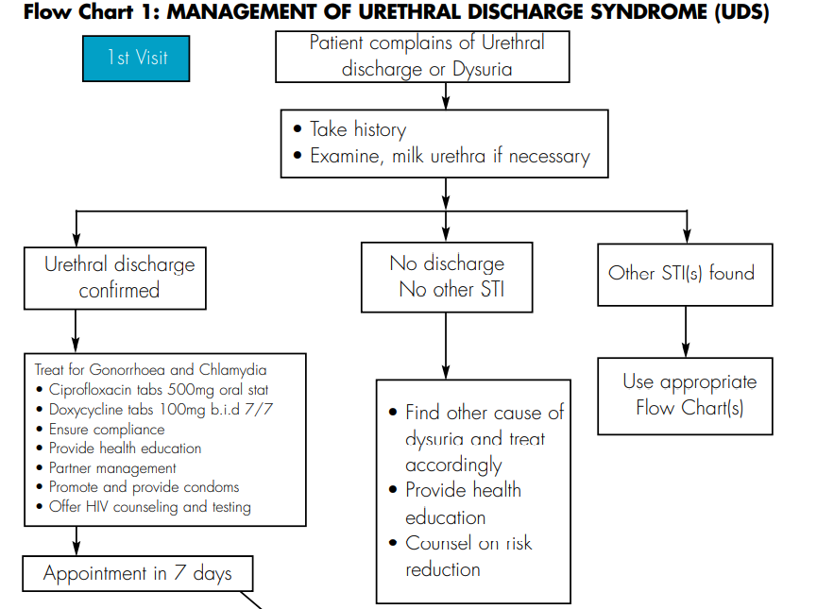
TANZANIA TREATMENT GUIDELINE

Slide 35
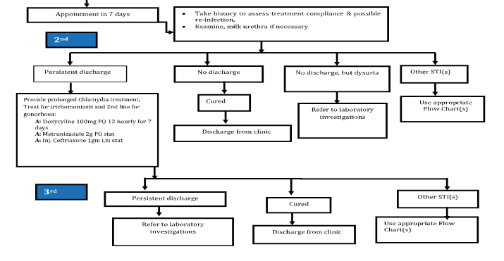

Slide 36
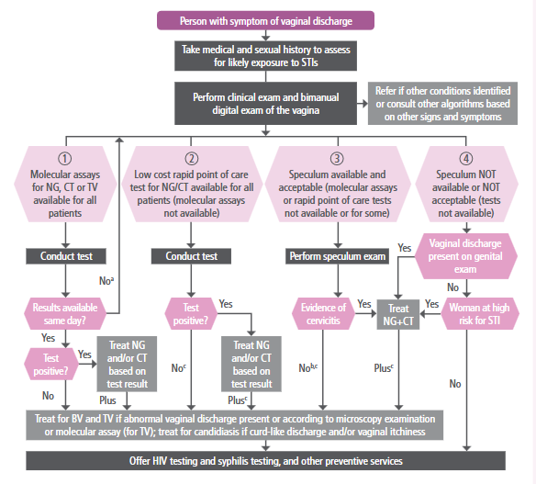
VAGINAL DISCHARGE SYNDROME

Slide 37
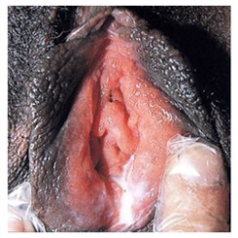

Slide 38
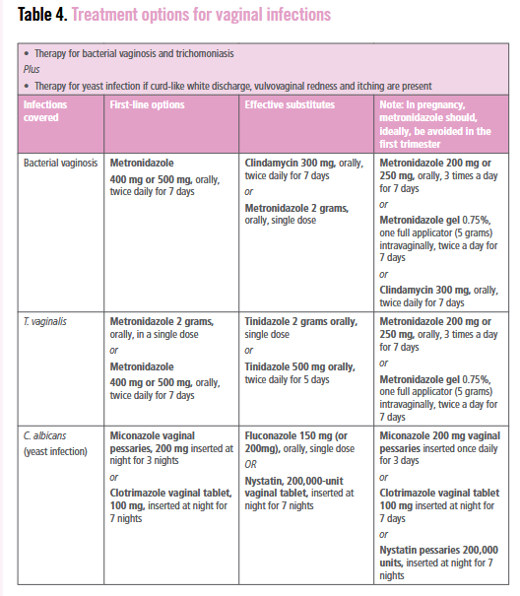
WHO RECOMMENDED TREATMENT
Notes:
In pregnancy low dose, short term recommended to prevent risk- preterm

Slide 39
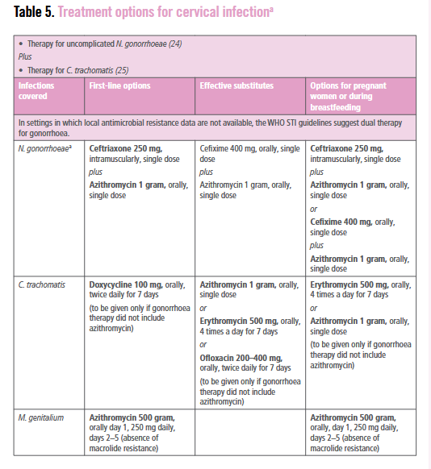

Slide 40
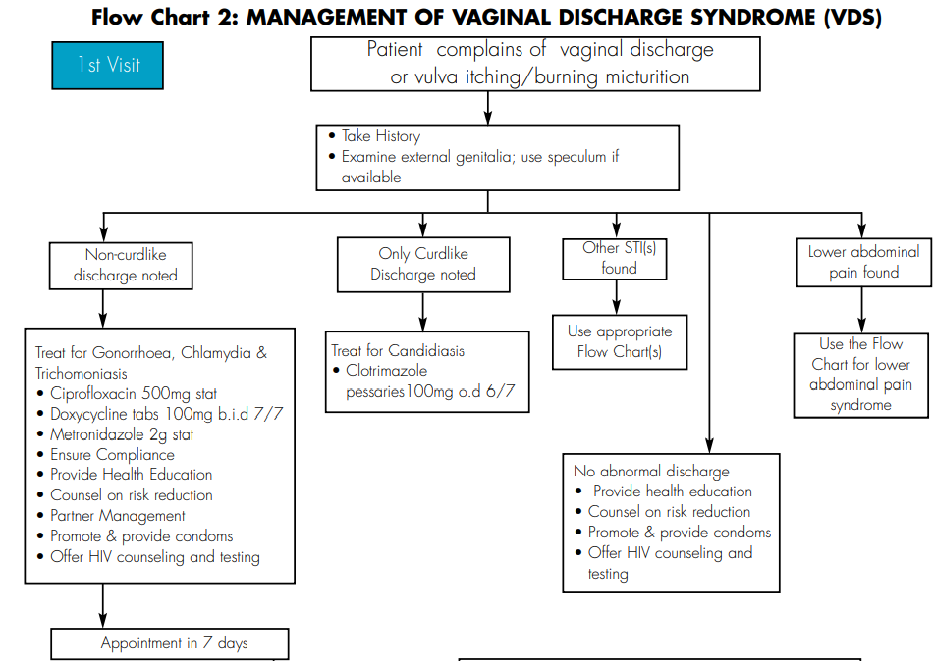
VAGINAL DISCHARGE SYNDROME

Slide 41
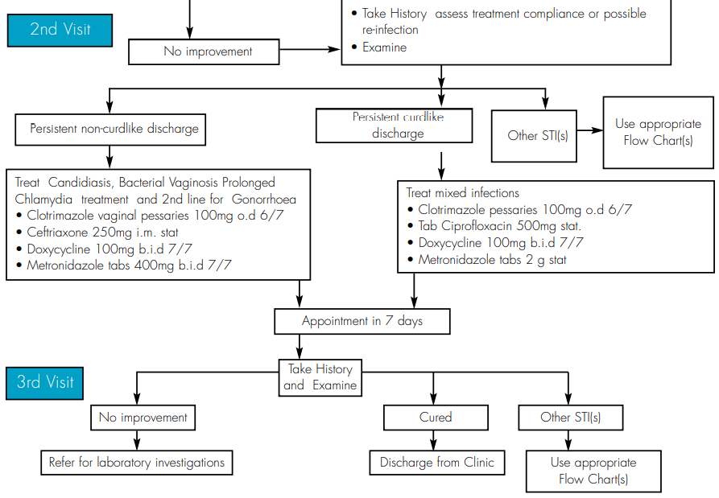
VDS CONT….

Slide 42
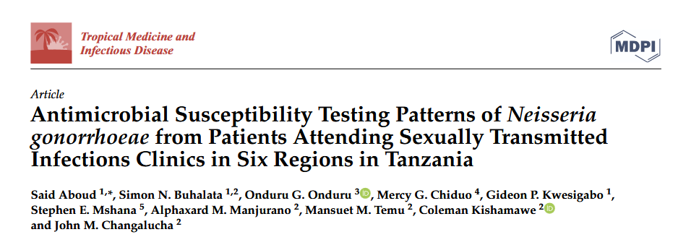

Slide 43
Article review
Study Objective: To determine the antimicrobial susceptibility patterns of Neisseria gonorrhoeae isolates from STI patients in six regions of Tanzania from 2014 to 2016
Study Methods: In vitro antimicrobial testing of 164 N. gonorrhoeae isolates was conducted using E-Test and agar dilution methods to assess resistance profiles

Slide 44
Findings:
The prevalence of resistant N. gonorrhoea to tetracycline, norfloxacin, penicillin and ciprofloxacin were 98.6%, 82.2%, 84.3% and 75.6%, respectively
The overall MDR-NG was 79.9%, and XDR-NG was 3.6%
None of the isolates was resistant to kanamycin
Conclusion & recommendations:
The study highlights alarming levels of antimicrobial resistance in N. gonorrhoea, emphasizing the need for robust surveillance and tailored treatment strategies in Tanzania
Notes:
MDR was defined as a resistance of more than one of previously recommended antimicrobial agents namely
penicillin, ciprofloxacin, norfloxacin, tetracycline, and erythromycin, plus one or more
of the currently recommended antimicrobial agents—ceftriaxone, cefixime, cefuroxime,
spectinomycin, and kanamycin and azithromycin.
XDR was defined as a resistance of one or more antimicrobial agents to currently recommended regimen plus three or more of
previously recommended antimicrobial agents (CLSI, 2013).

Slide 45
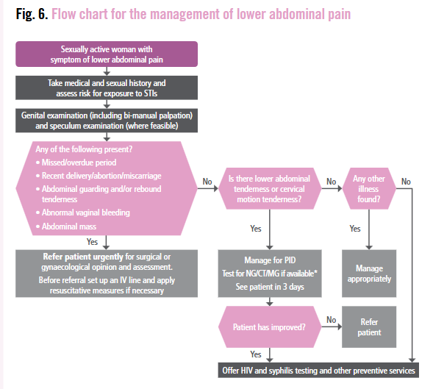
LOWER ABDOMINAL PAIN (PID)

Slide 46
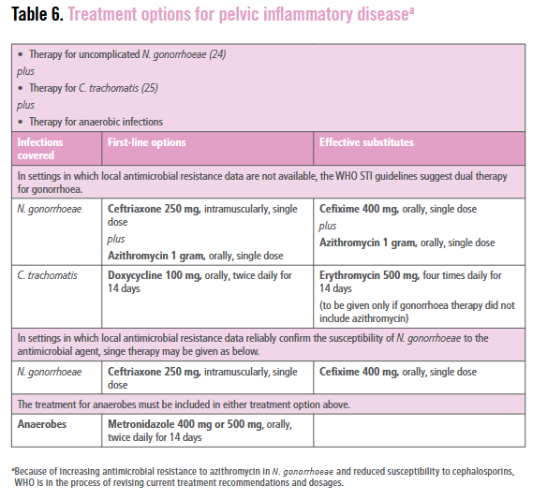
WHO RECOMMENDED TREATMENT

Slide 47
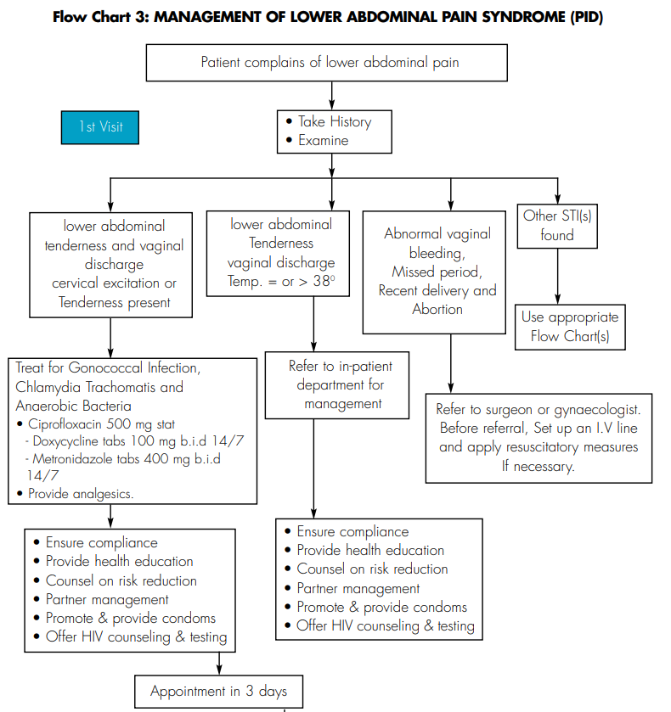
TANZANIA TREATMENT GUIDELINE

Slide 48
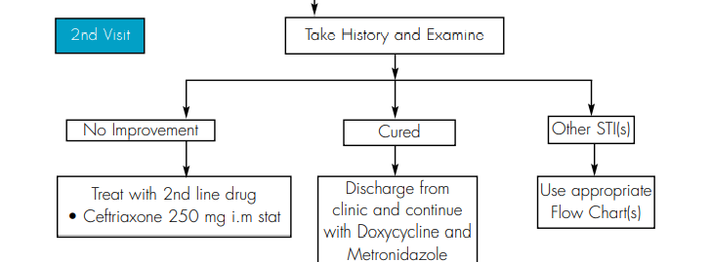
PID CONT…

Slide 49
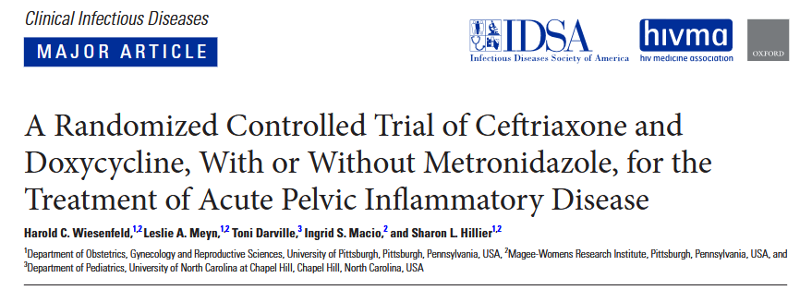
Notes:
STUDY DONE IN U.S.A BETWEEN NOVEMBER 2010-JANUARY 2015 ,PUBLISHED FEBRUARY 2020.

Slide 50
Article review
Study Objective: To determine whether adding Metronidazole to standard PID treatment (Ceftriaxone + Doxycycline) improves clinical and microbiological outcomes, particularly by enhancing anaerobic coverage.
Study Methods :
Randomized, double-blind, placebo-controlled trial 233 women with acute PID Compared: Ceftriaxone (single dose) + doxycycline (14 days)
with vs without metronidazole (14 days)
Primary Outcomes: Short-term clinical improvement (at 3 days)
Additional outcomes: Microbiological and clinical outcomes at 30 days

Slide 51
Findings:
No difference in early clinical improvement (day 3)
At 30 days, metronidazole group showed:
  Lower anaerobic infection (8% vs 21%)
  Reduced Mycoplasma genitalium prevalence (4% vs 14%)
  Less pelvic tenderness (9% vs 20%)
Adherence and side effects were similar between groups

Slide 52
Conclusion:
Adding metronidazole is safe, well tolerated, and improves microbiological and clinical outcomes
Supports routine inclusion of metronidazole in standard PID treatment regimens

Slide 53
WHAT IS NEW?
WHO is shifting from traditional syndromic management toward etiologic and molecular diagnosis of STIs
Expanded screening for asymptomatic:
Gonorrhea
Chlamydia
Focus on high-risk groups: adolescents and young adults, pregnant women, sex workers, MSM
World Health Organization. WHO guideline on the management of asymptomatic sexually transmitted infections. Geneva: WHO; 2025.

Slide 54
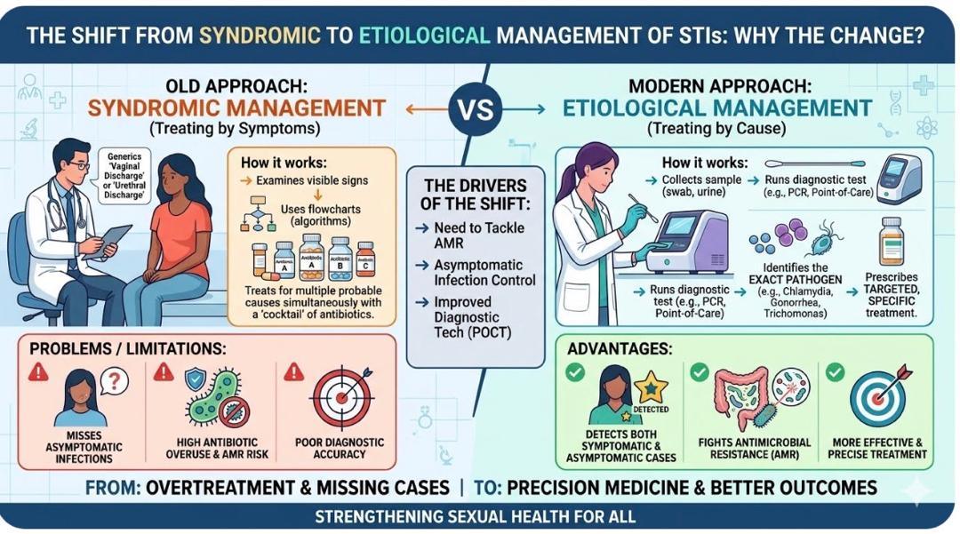
The Paradigm Shift

Slide 55
WHO RECOMMENDED TEST
1. Molecular Diagnostics (Gold Standard)
Nucleic Acid Amplification Tests (NAATs) are considered the gold standard for many STIs due to their high sensitivity (86.1%–100%) and specificity (97.1%–100%)
Polymerase Chain Reaction (PCR)
Multiplex Assays
Near Point of Care Assays

Slide 56
2. Rapid Point-of-Care (POC) Tests
WHO emphasizes the use of rapid tests that meet the ASSURED criteria (Affordable, Sensitive, Specific, User-friendly, Rapid/Robust, Equipment-free, and Delivered).
Rapid Syphilis Tests
Rapid HIV Test
Vaginal swab Test

Slide 57
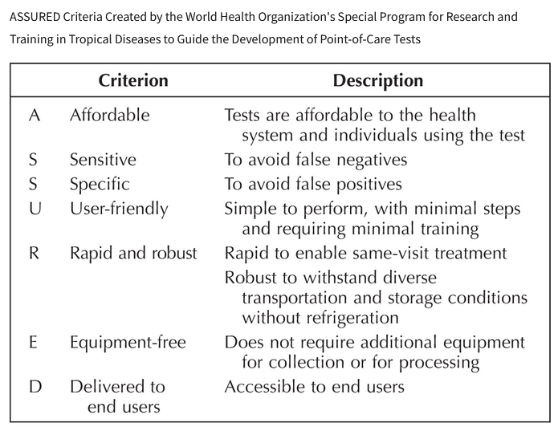

Slide 58
3. CRISPR-Based Diagnostics
Ultra-sensitive rapid STI detection
Potential future home-based testing technology
4. Self-Testing
Syphilis self-tests
Home STI kits
Digital-linked testing systems

Slide 59
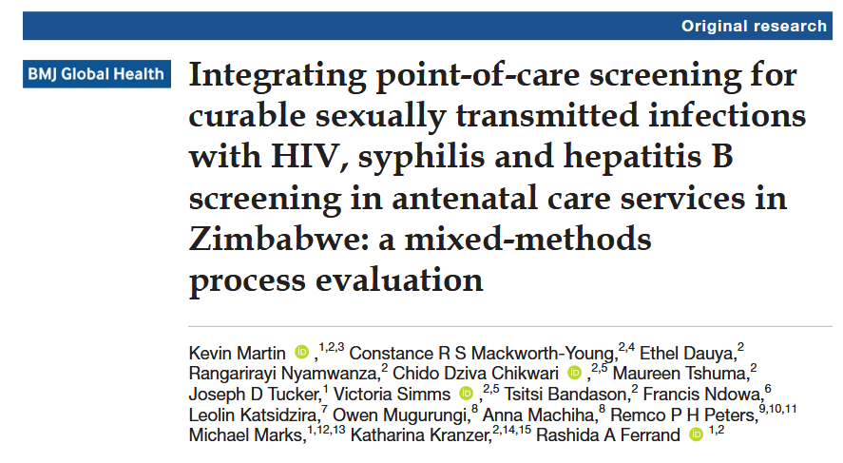

Slide 60
ARTICLE REVIEW
Objective:
To assess integration of point-of-care STI screening with HIV, syphilis, and hepatitis B testing in antenatal clinics in Zimbabwe
Methodology:
Mixed-methods study in antenatal care clinics
Between 12 January 2023 and 23 October 2023
Used point-of-care molecular STI testing alongside routine ANC screening
Evaluated feasibility, acceptability, and implementation challenges

Slide 61
Findings:
Integrated STI screening was feasible and acceptable Improved detection of asymptomatic STIs
Main challenges were staff workload, logistics, and training needs
Conclusion:
Point-of-care molecular STI screening in antenatal care can improve early STI diagnosis and supports shifting from syndromic to etiologic STI management

Slide 62
GONORRHEA
The 2nd most common bacterial STI
Caused by Gram negative , aerobic intracellular diplococci (Neisseria gonorrhoeae) affecting mostly the columnar or cuboidal epithelium
Age mostly affected is 15 to 29 .Mostly affect the cervix, urethra, rectum, throat, and occasionally the eyes
Global progress report on HIV, viral hepatitis and sexually transmitted infections, 2021". Geneva: WHO; 2021.· Link: WHO fact sheets on gonorrhea (published 2023-2024)
Notes:
The vulva and vagina in women are usually spared because they are lined by stratified epithelial cells

Slide 63
PATHOGENESIS
Gonococci attach to the host mucosal cell (by pill and opa proteins) within 24-48 hrs , penetrate through and between cells into the sub epithelia space
Host response → invasion with neutrophils followed by epithelial sloughing, formation of submucosal micro abscesses and purulent discharge

Slide 64
DIAGNOSIS
:
Sample
(urine, urethral swab, cervical/ vaginal swab, throat swab, rectal swab, eye swab, blood and synovial fluid)
Diagnostic methods
Gram stain and culture
PCR-based testing (NAAT)

Slide 65
TREATMENT(WHO)
Recommended regimens:
Ciprofloxacin, 500 mg orally, as a single dose OR
Azithromycin, 2 g orally, as a single dose OR
Ceftriaxone, 1gm by IV injection, as a single dose OR
Cefixime, 400 mg orally, as a single dose OR
Spectinomycin, 2 g by intramuscular injection, as a single dose.

Slide 66
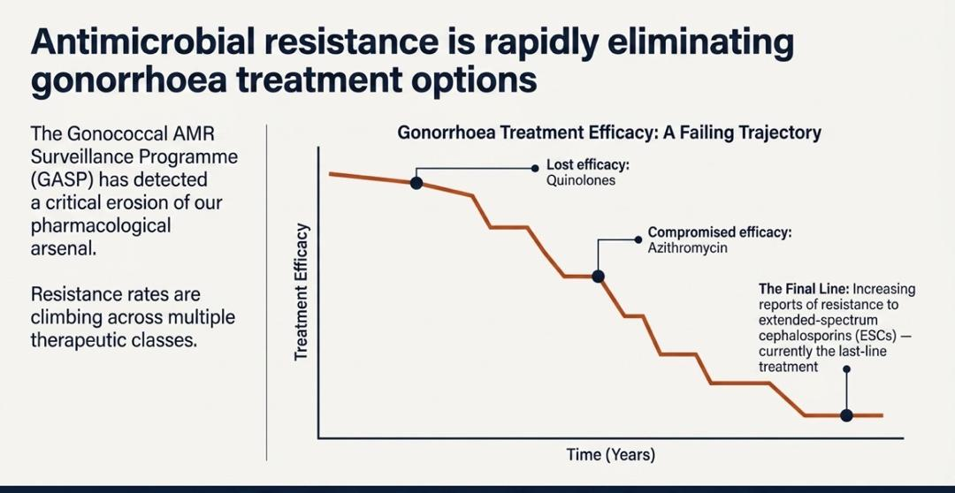
AMR IN THE MANAGEMENT OF GONORRHEA
Notes:
A Recent Study in India identified an XDR strain
The bacteria are evolving through confirmed genetic mutations such as penA alleles that lower te efficacy of ceftriaxone and specific 23S rRNA gene mutations that drive macrolide resistance

Slide 67
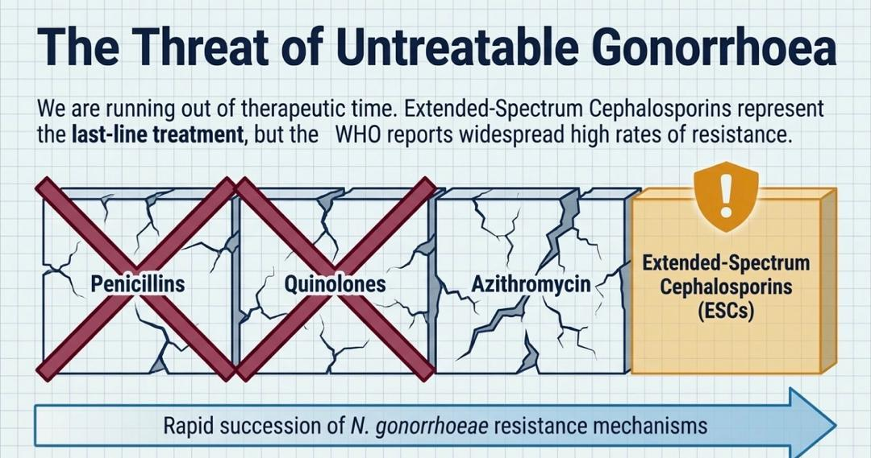
AMR IN THE MANAGEMENT OF GONORRHEA

Slide 68
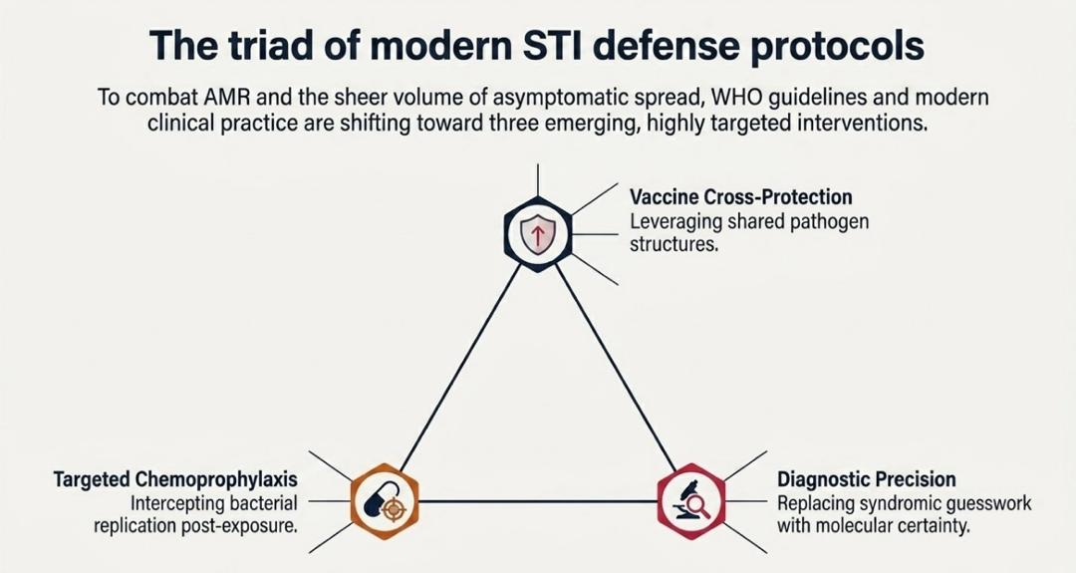

Slide 69
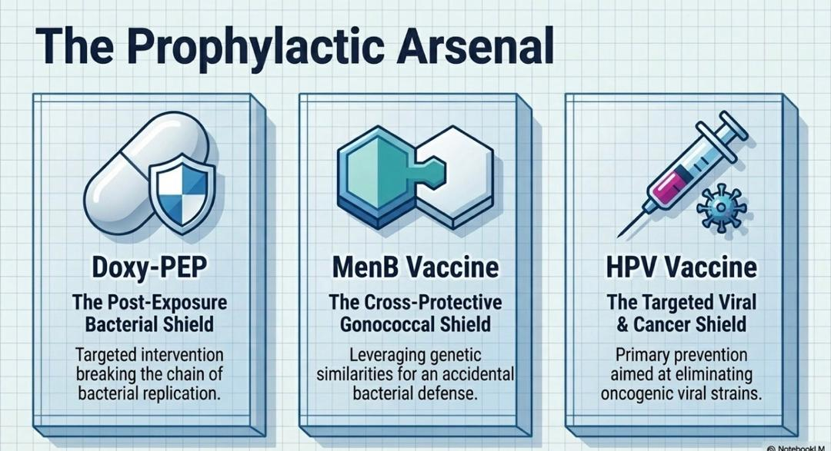

Slide 70
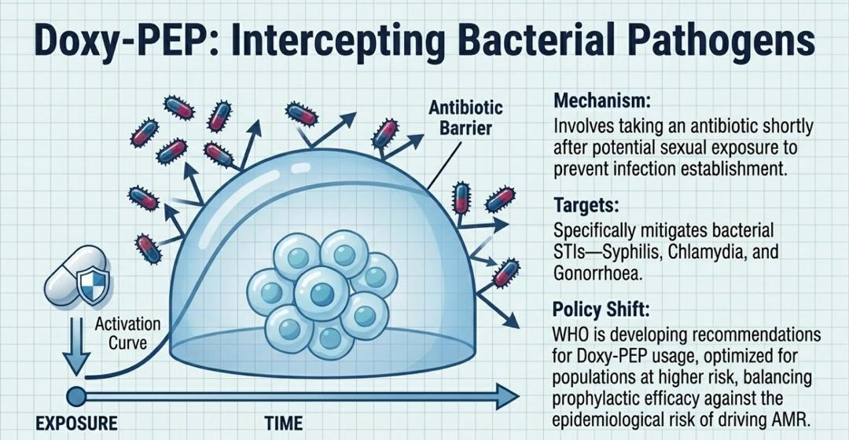

Slide 71
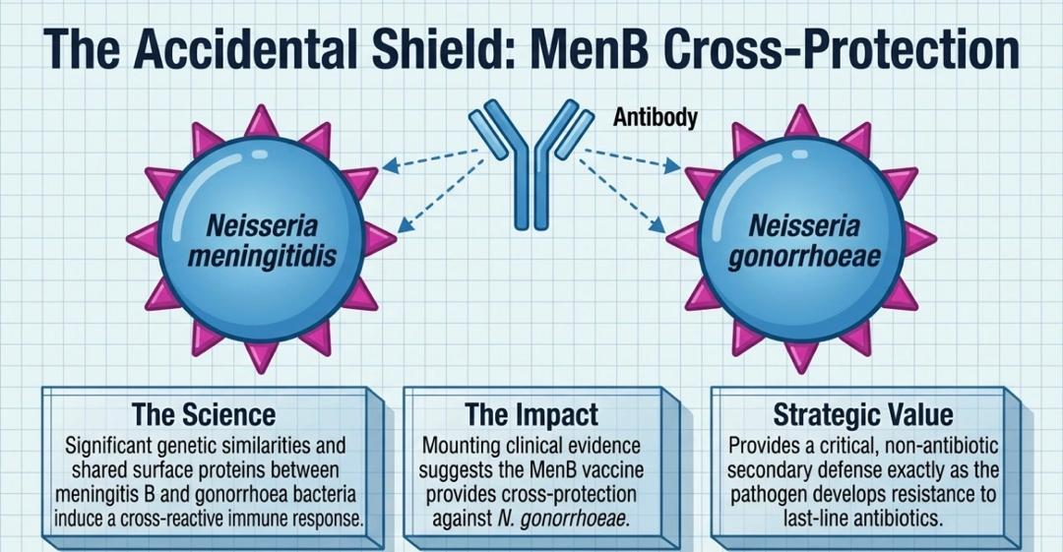

Slide 72
NEW HOPE IN THE DRUG PIPELINE
FDA approved gepotidacin (Blujepa) in December 2025 for uncomplicated urogenital gonorrhea
A first new class of oral antibiotic for gonorrhea in over 30 years
Approval based on the EAGLE-1 trial, where a single oral dose of gepotidacin was 92.6% effective, matching the current standard of care; critical in the current AMR era.
Ross JDC et al. Oral gepotidacin for the treatment of uncomplicated urogenital gonorrhoea (EAGLE-1): a phase 3 randomised, open-label, non-inferiority, multicentre study. Lancet. 2025 May 3;405(10489):1608-1620. doi: 10.1016/S0140-6736(25)00628-2. Epub 2025 Apr 14. PMID: 40245902.

Slide 73
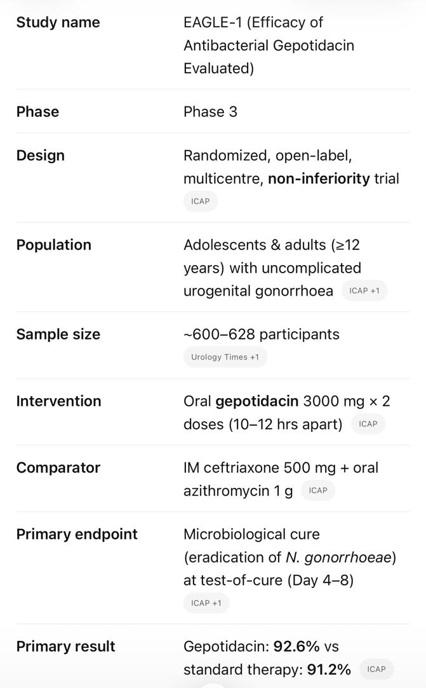
EAGLE-1 TRIAL

Slide 74
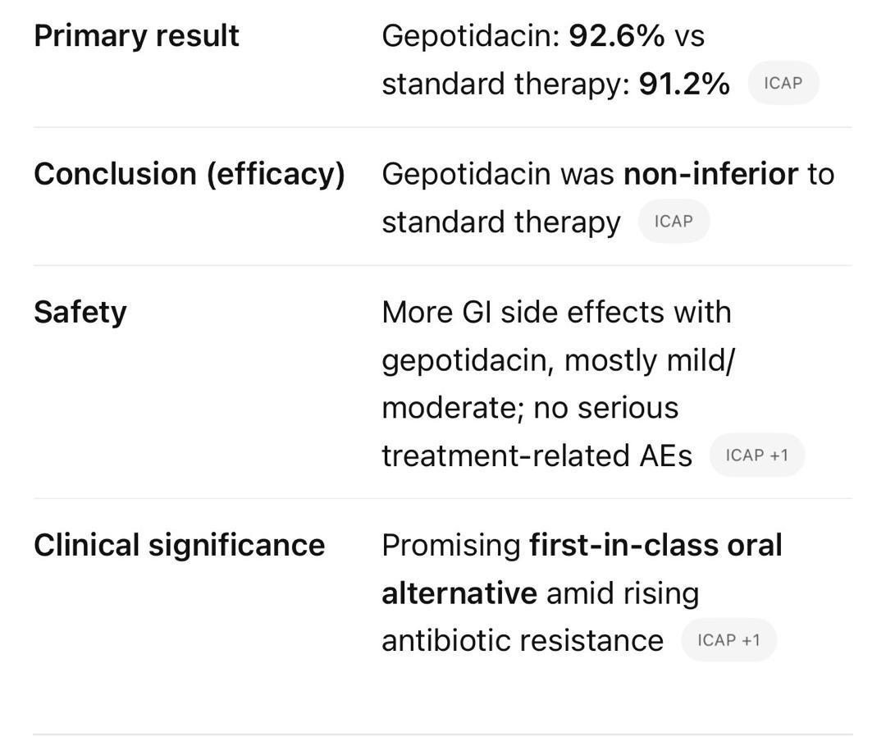
EAGLE-1 TRIAL…

Slide 75
SYPHILIS
Syphilis is a systemic disease caused by the spirochete T. pallidum
WHO estimates that 8 million adults between the ages 15 and 49 years acquired syphilis in 2024 globally
Syphilis in pregnancy when not treated ,treated late or treated with incorrect antibiotics, results in 50-80% cases of adverse birth outcomes
Can be congenital or acquired
  It has four stages ;primary, secondary, latent and tertiary
  Tertiary stage include: gummatous syphilis, cardiovascular syphilis and neurosyphilis

Slide 76
Stages of Syphilis
  Primary Syphilis
  Incubation period (3 weeks – 3Months) macule→papule→ulcer-clear base,sharp margin, painless, firm, non-itchy chancre
  Can be single/multiple (HIV)

Slide 77
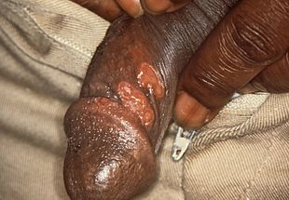
PRIMARY SYPHILIS CHANCRE

Slide 78
  Secondary Syphilis
  Manifests (4– 10 weeks) after primary infection. Involves skin, mucous membranes and lymphnodes.
  Skin lessions→symmetrical ,reddish-pink,non-itchy rash on the trunk and extremities including the palms and soles→the rash may become maculopapular/pustular
  Mucous membranes→ condyloma latum—flat, broad,whitish, wart-like lesions
Other symptoms→fever, sore throat,malaise,weight loss,hair loss,headache

Slide 79
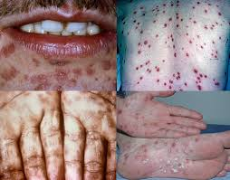

Slide 80
Cont…..
Latent Syphilis
Having serological proof of infection without symptoms of disease and sub divided as:
Early latent ( <1 year after secondary syphilis)- may have relapse of symptoms
Late latent (>1 year after secondary syphilis)-usually asymptomatic

Slide 81
Cont….
Tertiary Syphilis
3 to 15 years after initial infection
Exists into 3 different forms:
Gummatous/late benign syphilis(most common)→formation of chronic gummas (soft,tumor-like balls of inflammation)→typically affect skin, bone and liver
Late neurosyphilis →CNS, meningitis, tabes dorsalis,
generalized paresis, seizure, dementia, bilateral small pupils
Cardiovascular syphilis→ syphilitic aortitis→aortic aneurysm

Slide 82
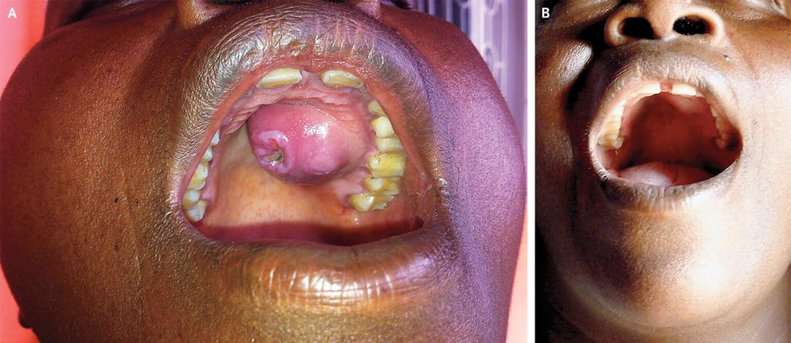
TERTIARY SYPHILIS-GUMMAS

Slide 83
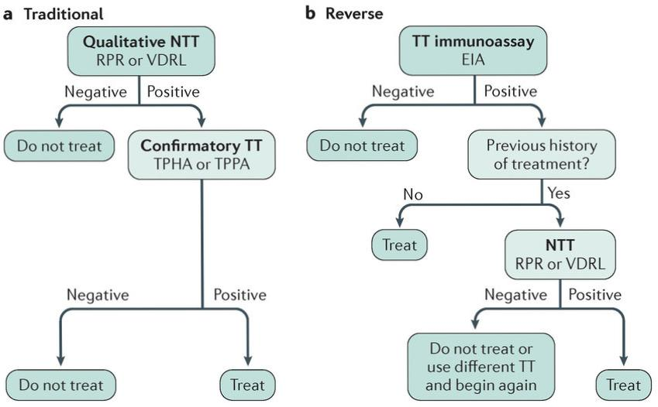
Investigations

Slide 84
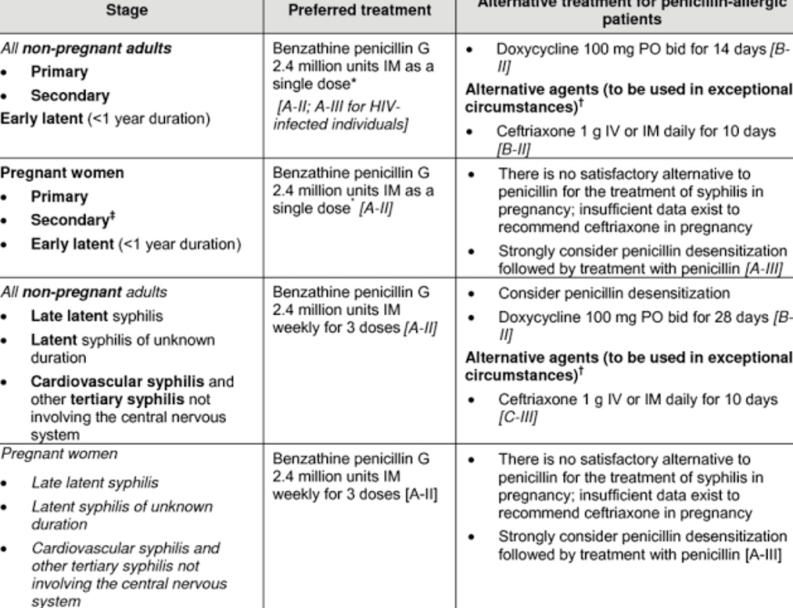
TREATMENT OF SYPHILIS (WHO)
Notes:
In Neurosyphilis: Aqueous Crystalline Pen G: 18-24 MU/day administered as 3-4 MU IV every 4 hrs or continuous, for 10-14 days (To achieve adequate CNS drug levels). Alt: Procaine Penicillin (2.4 MU IM od)+ Probenecid (500 mg orally qid) for 10 – 14 days OR Ceftriaxone: 2g IV/IM od – 10-14 days, LP at six month interval until CSF normalizes

Slide 85
HUMAN PAPILLOMA INFECTION
HPV infection is caused by a human papillomavirus, a DNA virus from the papillomavirus family
HPV infection is limited to the basal cells of stratified epithelium, the only tissue in which they replicate
Over 150 types are known
HPV vaccines can prevent the most common types of infection
Notes:
People can become infected with more than one type of HPV
To be effective, they must be used before an infection occurs and are therefore recommended between the ages of 9 and 13

Slide 86
HPV CONT….
DISEASE | HPV TYPE
Common warts(hands/feet) | 2,7,22
Plantar warts(soles of feet,grow inward) | 1,2,4,63
Flat warts(arms,face,forehead) | 3,8,10
Anogenital warts | 6,11,42,44
Anal dysplasia(lesions) | 6,16,18,31,53,58
Genital cancers | 16,18,31,45 (highest risk)
Focal epithelial hyperplasia | 13,32
Mouth papillomas | 6,7,11,16,32
Oropharyngeal cancer | 16
Verrucous cyst | 60
Laryngeal papillomatosis | 6,11

Slide 87
PATHOGENESIS
HPV virion infects epithelial tissues (basal cells of stratified epithelium) through micro-abrasions
Virion associates with putative receptors such as alpha integrins and laminins
  leading to entry of the virions into basal epithelial cells through → clathrin-mediated endocytosis and/or caveolin-mediated endocytosis depending on the type of HPV
The viral genome is transported to the nucleus by unknown mechanisms and establishes itself at a copy number of 10-200 viral genomes per cell
A sophisticated transcriptional cascade then occurs as the host keratinocyte begins to divide and become increasingly differentiated in the upper layers of the epithelium

Slide 88
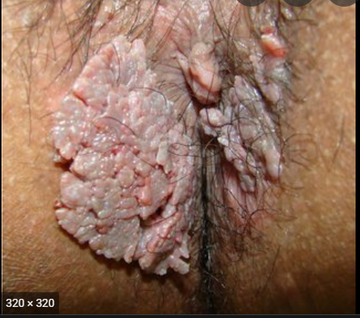
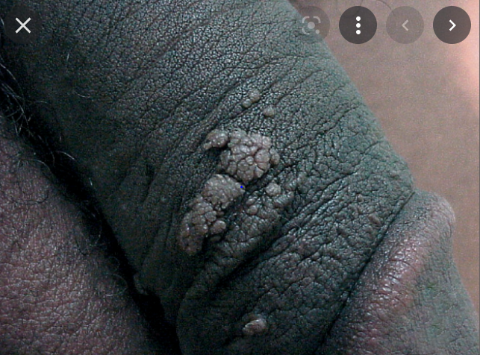
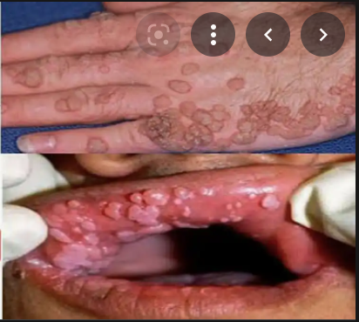
SIGNS AND SYMPTOMS

Slide 89
DIAGNOSIS
HPV
Pap smear
HPV DNA detection method(PCR,ISH,SBH)
Biopsy

Slide 90
RECOMMENDED TREATMENT( WHO)
Chemical
Podofilox 0.5% solution or gel applied twice daily for 3 days, followed by 4 days of no treatment, and the cycle repeated up to 4 times
Imiquimod 5% cream applied with a finger at bedtime, left on overnight, 3 times a week for as long as 16 weeks
Physical
Cryotherapy with liquid nitrogen, solid carbon dioxide, or a cryoprobe. Applied every 1-2 weeks
Electrosurgery
Surgical removal

Slide 91

HPV VACCINE

Slide 92
Hepatitis B
Around 65-82 million people in Africa live with chronic HBV
MTCT and Horizontal transmission during early childhood accounts for major transmission in Africa
Tanzania is classified as an intermediate-to-high endemic country
Overall prevalence ~ 6.9%

Slide 93


Slide 94
Article review
Study Objective: Overall prevalence of HBV infection in Tanzania by reviewing available epidemiological studies
Study Methods : Systematic review and meta analysis, HBV infection determined by HBsAg positivity
Findings : Overall pooled prevalence ~ 6.9%
Conclusion : HBV remains a significant public health problem in Tanzania

Slide 95

HBV Structure

Slide 96

Pathogenesis

Slide 97


Slide 98


Slide 99


Slide 100
Diagnosis
Definitive diagnosis of HBV depends on serological demonstration of the viral markers
  HBsAg, general marker of infection
  HBeAg, active replication of the virus, infectiveness
  Anti-HBs, document recovery and/or immunity to HBV infection
  Anti-HBe, virus no longer replicating
  Anti-HBc IgM, marker of acute infection
  Anti-HBc IgG, past or chronic infection
  HBV DNA, active replication of virus, more accurate, used mainly for monitoring response to therapy

Slide 101


Slide 102


Slide 103


Slide 104
Treatment
Acute Hepatitis B
Among previously healthy adults, recovery occurs > 95%
Antiviral therapy is unnecessary
Specific antiviral drugs are indicated in fulminant hepatitis
  Tenofovir (TDF or TAF)

Slide 105


Slide 106


Slide 107


Slide 108


Slide 109
Prevention
Active Immunization (Hepatitis B Vaccine)
Recombinant subunit vaccine
The surface antigen (HBsAg) used as vaccine candidate
IM route over deltoid (antero-lateral thigh in infant)
Schedule
3 doses are given at 0, 1 and 6 months for adults
At 6, 10, 14 weeks along with DPT under IVD program

Slide 110
Prevention Cont…
Marker of Protection
If anti-HBsAg antibody titer > 10 IU/ml
5-10% of vaccinated individuals are non and low responders
Protection may last for about 15 years or longer
Booster doses are needed after 5 years, especially high risk group if antibody titer falls below 10 IU/ml

Slide 111
Prevention Cont…
Passive Immunization (HBIG)
Neonates borne to hepatitis B carrier mother
Acutely exposed to HBsAg positive blood eg, surgeons, nurses
Post-liver transplant patient who needs protection against HBV infection

Slide 112


Slide 113
Prevention Cont…
Post exposure prophylaxis
Vaccinated + Anti-HBs > 10 IU/ml : No treatment
Vaccinated + Anti-HBs <10 IU/ml : HBIG immediately + 1 booster dose of Hepatitis B vaccine
Not vaccinated : HBIG immediately + start full vaccine series (0,1, 6 months)

Slide 114
Challenges in Hepatitis B vaccination
Low birth dose coverage
Limited Adult vaccination
Inadequate screening before vaccination
Poor coverage in high risk groups
Lack of post vaccination Antibody test
Vaccine access and supply issues

Slide 115
PREVENTION OF STIs
Encourage sexual abstinence
Encouraging health seeking behavior for early attendance, for screening examination after exposure and early treatment after appearance of signs and symptoms
Encourage condom use
Promotion of compliance to treatment
Male circumcision

Slide 116
COMPLICATIONS
Pelvic Inflammatory Disease
Menstrual irregularities
Infertility – men and women
Certain cancers– women & men– cervical and rectal
Pregnancy complications – ectopic pregnancy,pre-term delivery, spontaneous abortions, PROM and foetal/neonatal pathologies
Epididymitis

Slide 117
REFERENCES
Harfouche M, AlMukdad S, Alareeki A, Osman AMM, Gottlieb S, Rowley J, Abu-Raddad LJ, Looker KJ. Estimated global and regional incidence and prevalence of herpes simplex virus infections and genital ulcer disease in 2020: mathematical modelling analyses. Sex Transm Infect. 2025 May 19;101(4):214-223. doi: 10.1136/sextrans-2024-056307. PMID: 39658199
Bray F, Ferlay J, Soerjomataram I, Siegel RL, Torre LA, Jemal A. Global cancer statistics 2018: GLOBOCAN estimates of incidence and mortality worldwide for 36 cancers in 185 countries. CA Cancer J Clin. 2018 Nov;68(6):394-424. Epub 2018 Sep 12. Erratum in: CA Cancer J Clin. 2020 Jul;70(4):313.
Michalow J, Hall L, Rowley J, Anderson RL, Hayre Q, Chico RM, Edun O, Knight J, Kuchukhidze S, Majaya E, Reed DM, Stevens O, Walters MK, Peters RP, Cori A, Boily MC, Imai-Eaton JW. Prevalence of chlamydia, gonorrhoea, and trichomoniasis among male and female general populations in sub-Saharan Africa from 2000-2024: A systematic review and meta-regression analysis. medRxiv [Preprint]. 2024 Dec 16:2024.12.16.24319070. doi: 10.1101/2024.12.16.24319070. Update in: EClinicalMedicine. 2025 Apr 24;83:103210. doi: 10.1016/j.eclinm.2025.103210. PMID: 39763549; PMCID: PMC11702751.
Aboud S, Buhalata SN, Onduru OG, Chiduo MG, Kwesigabo GP, Mshana SE, Manjurano AM, Temu MM, Kishamawe C, Changalucha JM. High Prevalence of Sexually Transmitted and Reproductive Tract Infections (STI/RTIs) among Patients Attending STI/Outpatient Department Clinics in Tanzania. Trop Med Infect Dis. 2023 Jan 13;8(1):62. doi: 10.3390/tropicalmed8010062. PMID: 36668969; PMCID: PMC9863565.
Mcharo RD, Kisinda A, Njovu L, Mcharo M, Mbwilo F, Mihale G, Komba B, Andrew E, Mayaud P, Kroidl A, Ivanova O, Msuya SE. Prevalence of and risk factors associated with HIV, Herpes Simplex Virus-type 2, Chlamydia trachomatis and Neisseria gonorrhoeae infections among 18-24 year old students attending Higher Learning Institutions in Mbeya-Tanzania. PLoS One. 2022 May 26;17(5):e0266596. doi: 10.1371/journal.pone.0266596. PMID: 35617304; PMCID: PMC9135268.

Slide 118
REFERENCES…
6. Michalow J, Walters MK, Edun O, Wybrant M, Davies B, Kufa T, Mathega T, Chabata ST, Cowan FM, Cori A, Boily MC, Imai-Eaton JW. Aetiology of vaginal discharge, urethral discharge, and genital ulcer in sub-Saharan Africa: A systematic review and meta-regression. PLoS Med. 2024 May 20;21(5):e1004385. doi: 10.1371/journal.pmed.1004385. PMID: 38768094; PMCID: PMC11104670.
7. Aboud S, Buhalata SN, Onduru OG, Chiduo MG, Kwesigabo GP, Mshana SE, Manjurano AM, Temu MM, Kishamawe C, Changalucha JM. Antimicrobial Susceptibility Testing Patterns of Neisseria gonorrhoeae from Patients Attending Sexually Transmitted Infections Clinics in Six Regions in Tanzania. Trop Med Infect Dis. 2022 Jun 2;7(6):89. doi: 10.3390/tropicalmed7060089. PMID: 35736968; PMCID: PMC9231259.
8. Wiesenfeld HC, Meyn LA, Darville T, Macio IS, Hillier SL. A Randomized Controlled Trial of Ceftriaxone and Doxycycline, With or Without Metronidazole, for the Treatment of Acute Pelvic Inflammatory Disease. Clin Infect Dis. 2021 Apr 8;72(7):1181-1189. doi: 10.1093/cid/ciaa101. PMID: 32052831; PMCID: PMC8028096.
9. WHO. Guideline for the prevention, diagnosis, care and treatment for people with chronic hepatitis B infection. Geneva:World Health Organization; 29March2024.
10. CDC. Viral Hepatitis- Chronic Hepatitis B information and Guidelines- US. Evidence-based overview of HBV surveillance, prevention, monitoring and treatment approaches. 2024
11. EASL. Clinical Practice Guidelines on the management of hepatitis B virus infection, Journal of Hepatology 2025;83(2):502-583

Slide 119


